Slide 1
Lecture -13
Engineering Mechanics
Friction

Slide 2
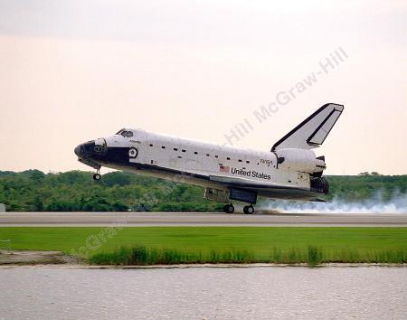
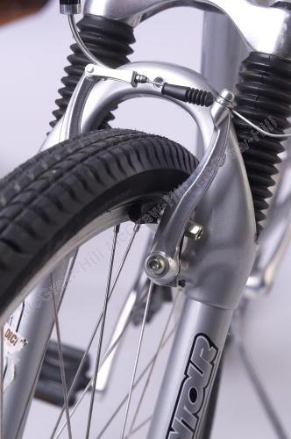
Friction is both problematic and useful in many engineering applications, such as in tires and brakes.

Slide 3
Introduction
Earlier our discussion was limited to the bodies whose surfaces in contact were either frictionless (surfaces could move freely with respect to each other) or rough (tangential forces prevent relative motion between surfaces).
Actually, no perfectly frictionless surface exists. For two surfaces in contact, tangential forces, called friction forces, will develop if one attempts to move one relative to the other.
However, the friction forces are limited in magnitude and will not prevent motion if sufficiently large forces are applied.
The distinction between frictionless and rough is, therefore, a matter of degree.
There are three types of friction: dry or Coulomb friction, Skin or greasy friction and film or viscous friction. Film friction occurs due to shearing of different layers of lubricants. The present discussion is limited to dry friction between non lubricated surfaces.

Slide 4
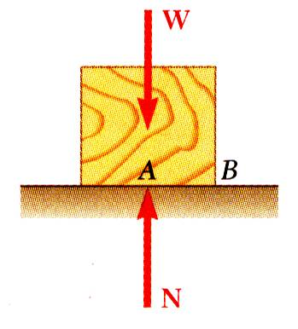
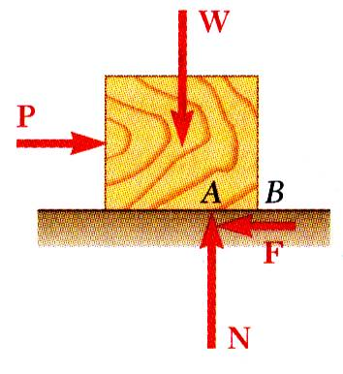
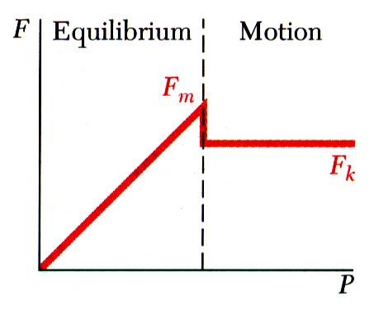
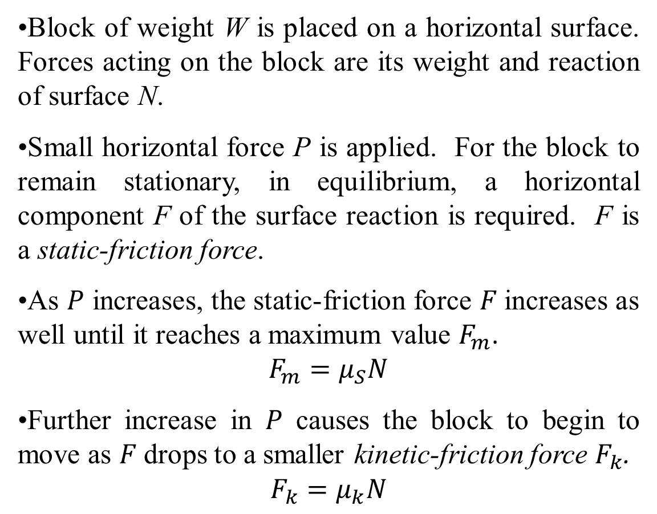
Introduction
Block of weight W is placed on a horizontal surface. Forces acting on the block are its weight and reaction of surface N.
Small horizontal force P is applied. For the block to remain stationary, in equilibrium, a horizontal component F of the surface reaction is required. F is a static-friction force.
As $P$ increases, the static-friction force $F$increases as well until it reaches a maximum value $F_{m}$.
$$F_{m}=μ_{S}N$$
Further increase in $P$ causes the block to begin to move as $F$drops to a smaller kinetic-friction force $F_{k}$.
$$F_{k}=μ_{k}N$$

Slide 5
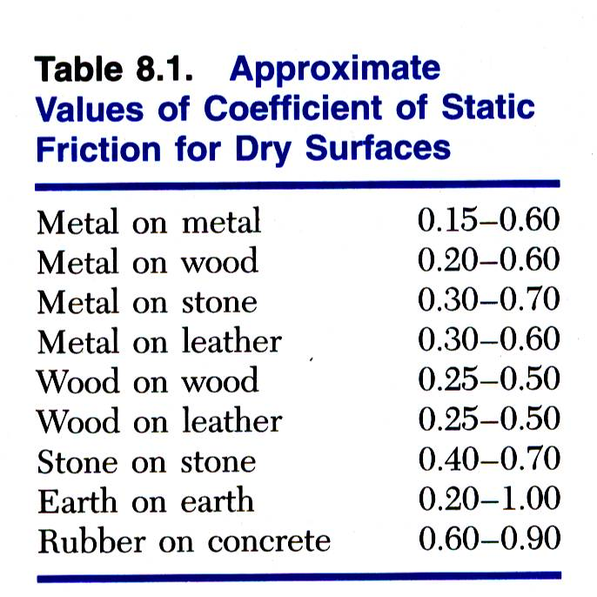
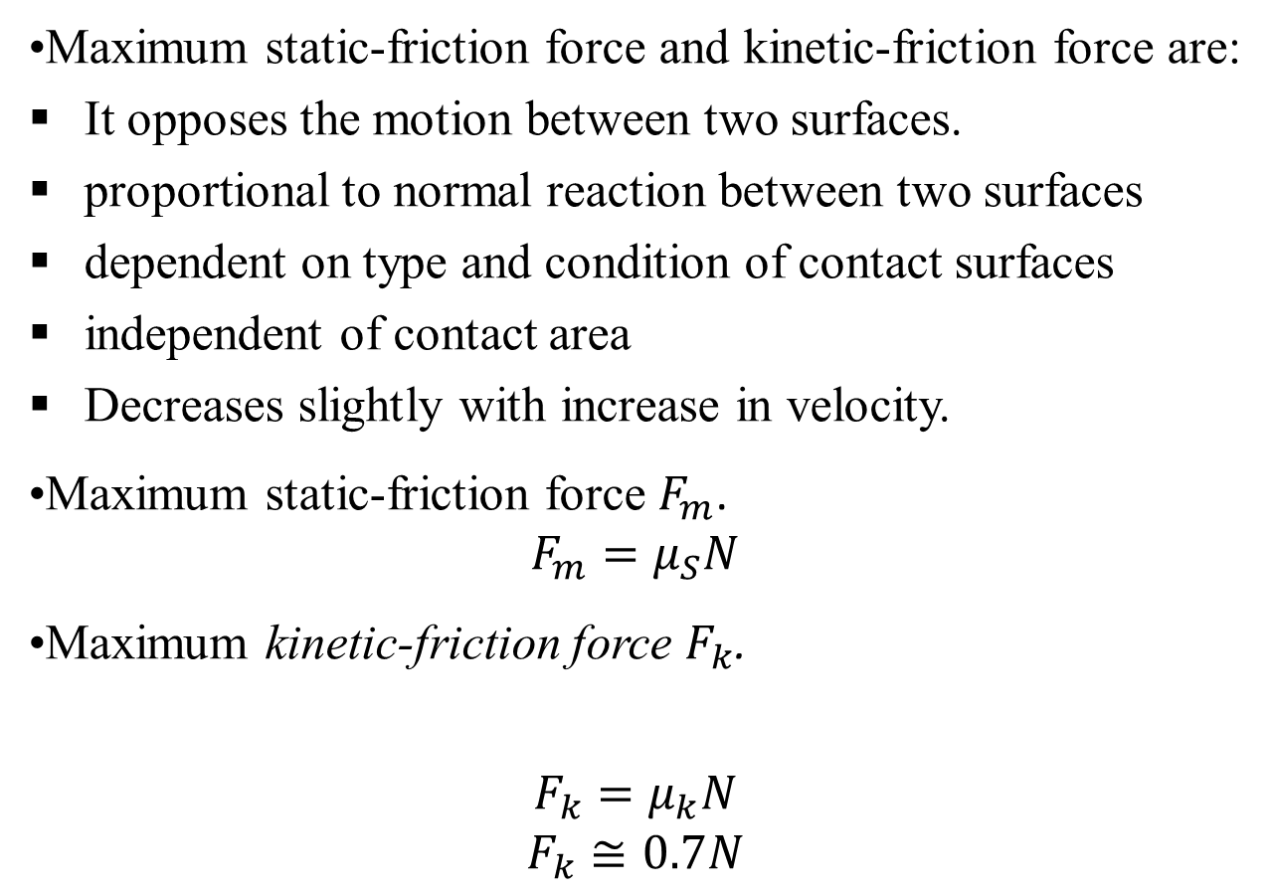
Laws of Dry Friction
Maximum static-friction force and kinetic-friction force are:
It opposes the motion between two surfaces.
proportional to normal reaction between two surfaces
dependent on type and condition of contact surfaces
independent of contact area
Decreases slightly with increase in velocity.
Maximum static-friction force $F_{m}$.
$$F_{m}=μ_{S}N$$
Maximum kinetic-friction force $F_{k}$.
$$F_{k}=μ_{k}N$$
$$F_{k}≅0.7N$$

Slide 6
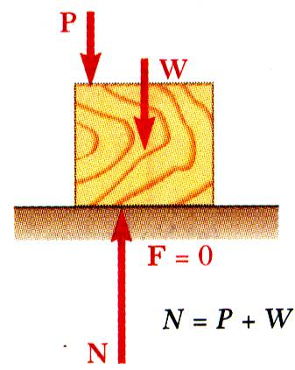
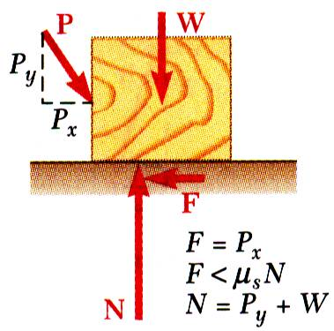
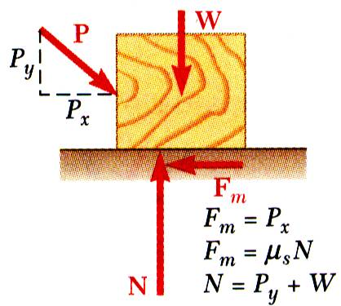
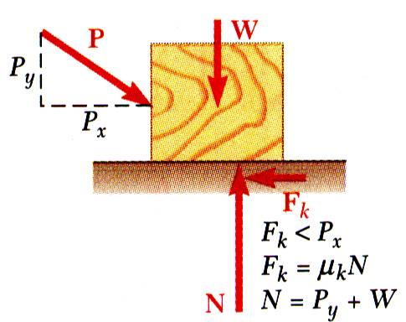
Laws of Dry Friction
No friction, (P_{x} = 0)
No motion, (P_{x} < F)
Motion impending, (P_{x} = F_{m})
Motion, (P_{x} > F_{m})

Slide 7
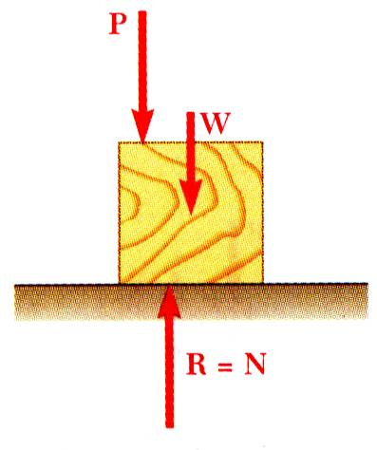
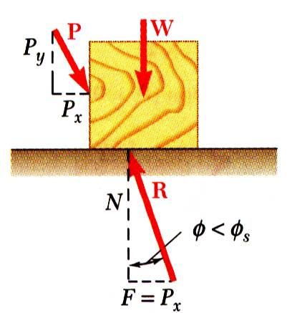
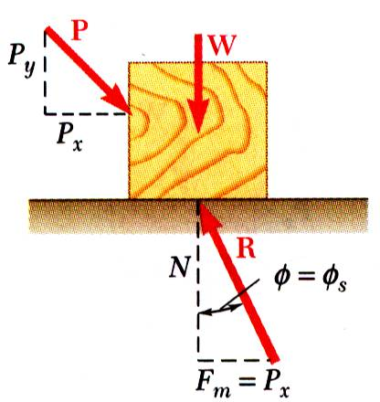
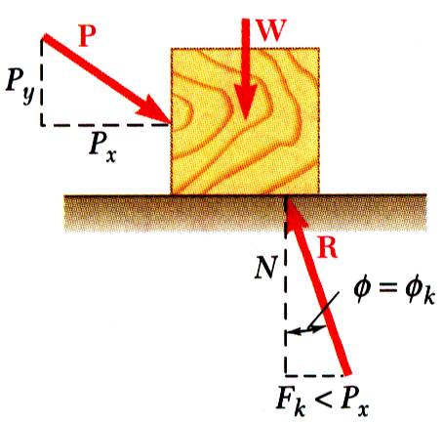
Angle of Friction
It is the angle between the resultant (resultant of normal reaction and limiting frictional force) with the normal reaction.
No friction
No motion
Motion impending
Motion

Slide 8





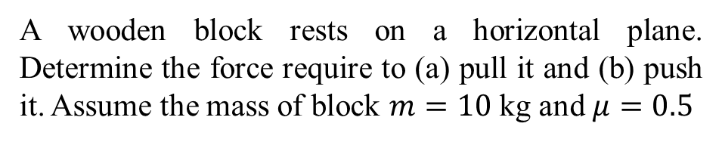
Sample Problem
$${15}^{0}$$
$${15}^{0}$$
$$W$$
$${μR}_{n}$$
$$W=mg$$
$$R_{n}$$
A wooden block rests on a horizontal plane. Determine the force require to (a) pull it and (b) push it. Assume the mass of block $m=10$ kg and $μ=0.5$

Slide 9









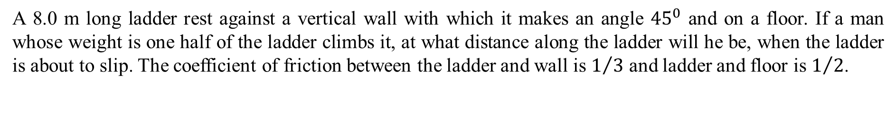

Sample Problem
A 8.0 m long ladder rest against a vertical wall with which it makes an angle ${45}^{0}$ and on a floor. If a man whose weight is one half of the ladder climbs it, at what distance along the ladder will he be, when the ladder is about to slip. The coefficient of friction between the ladder and wall is $1/3$ and ladder and floor is $1/2$.
L=40/7
$$R_{B}$$
$$8$$
$${1/3R}_{B}$$
$$l$$
$$4$$
$$W/2$$
$${45}^{0}$$
$$W$$
$${1/2R}_{A}$$
$$R_{A}$$

Slide 10
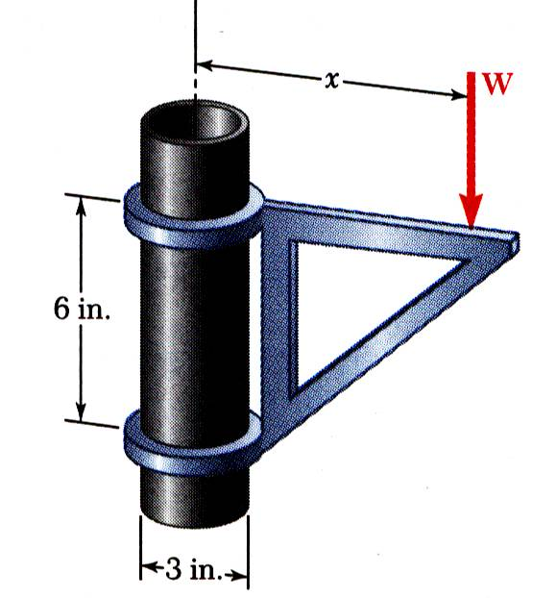
Sample Problems
The moveable bracket shown may be placed at any height on the 3-in. diameter pipe. If the coefficient of friction between the pipe and bracket is 0.25, determine the minimum distance x at which the load can be supported. Neglect the weight of the bracket.

Slide 11
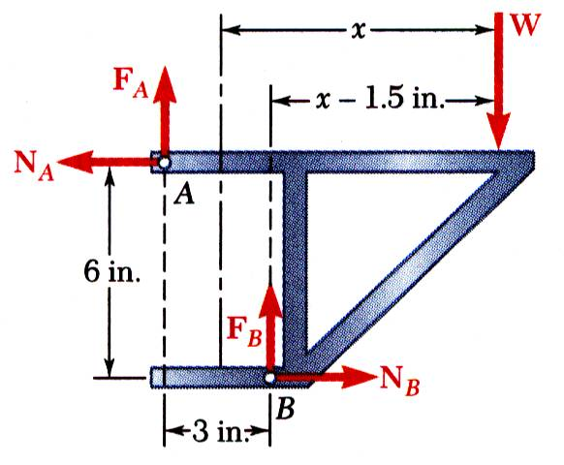
Types of problems

Slide 12









Inclined plane: 1. Body at rest
$$R$$
$$R_{n}$$
$$α$$
$$F^{′}$$
$$W\sin{α}$$
$$α$$
$$α$$
$$W\cos{α}$$
$$W$$

Slide 13



















Inclined plane: 2. Motion up the plane
$$F_{min}$$
$$π−θ$$
$$F$$
$$R_{n}$$
$$R$$
$$F$$
$$φ+α$$
$$R$$
$$α$$
$$φ$$
$$φ$$
$$θ$$
$${μR}_{n}$$
$$θ$$
$$π−(φ+α)$$
$${90}^{0}+α$$
$$α$$
$$W$$
$$W$$

Slide 14













Inclined plane: 3. Motion down the plane
$$R$$
$$φ−α$$
$$R_{n}$$
$$F$$
$$R$$
$$α$$
$$φ$$
$${μR}_{n}$$
$$θ$$
$$π−(φ−α)$$
$$θ$$
$$α$$
$$π−θ$$
$$F$$
$$π−θ$$
$$W$$
$$W$$

Slide 15
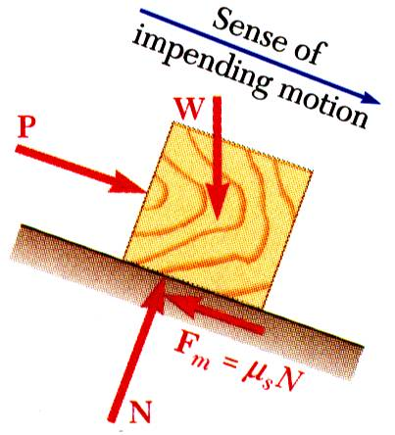
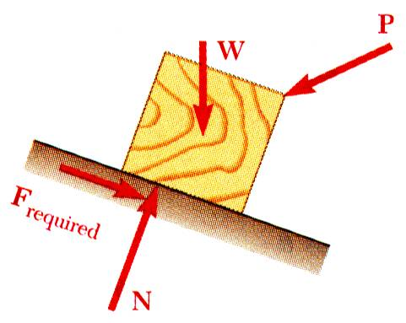
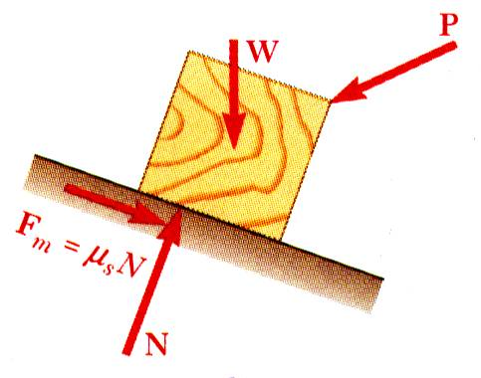
Types of problems
All applied forces known
Coefficient of static friction is known
Determine whether body will remain at rest or slide
All applied forces known
Motion is impending
Determine value of coefficient of static friction.
Coefficient of static friction is known
Motion is impending
Determine magnitude or direction of one of the applied forces

Slide 16
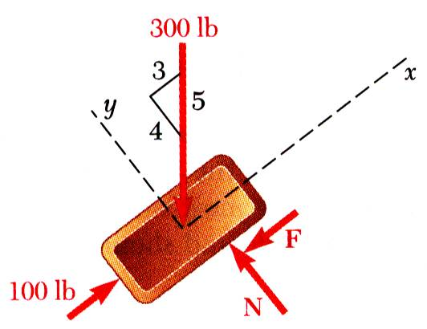
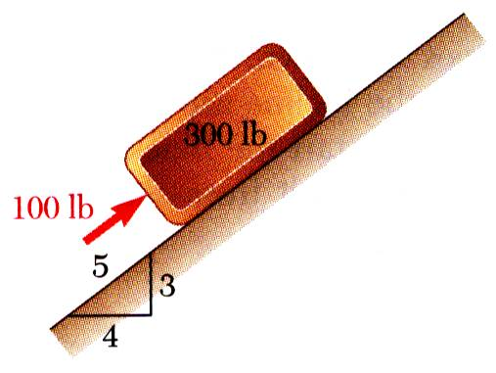
Types of problems
A 100 lb force acts as shown on a 300 lb block placed on an inclined plane. The coefficients of friction between the block and plane are μ_{s} = 0.25 and μ_{k} = 0.20. Determine whether the block is in equilibrium and find the value of the friction force.
Ans. 48

Slide 17













Types of problems
Two blocks of weight $W_{1}=50 N$ and $W_{2}=100 N$ rest on a rough inclined plane and are connected by a string. The coefficient of friction between the inclined plane and $W_{1}$ and $W_{2}$ are $μ_{1}=0.3$ and $μ_{2}=0.2$, respectively. Find the inclination of the plane for which slipping will impend.
ANS. Tan^-1(7/30)
$$α$$
$$α$$
$$T$$
$${μ_{1}R}_{1}$$
$$W_{1}$$
$$W_{1}$$
$$R_{1}$$
$$W_{2}$$
$${μ_{2}R}_{2}$$
$$α$$
$$α$$
$$W_{2}$$
$$R_{2}$$

Slide 18
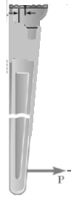
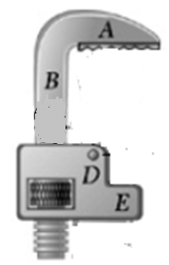

Types of problems
A pipe of diameter 3 in. is gripped by the stillson wrench as shown. Portions AB and DE of the wrench is rigidly attached to each other and portion CF is connected by a pin at D. If the wrench is to grip the pipe and to be self locking, determine the minimum coefficient of friction at A and C.

Slide 19
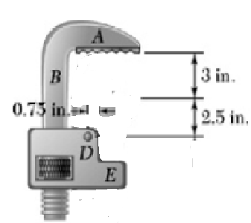
Types of problems
3 in.

Slide 20
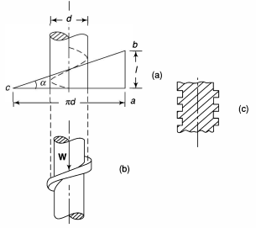
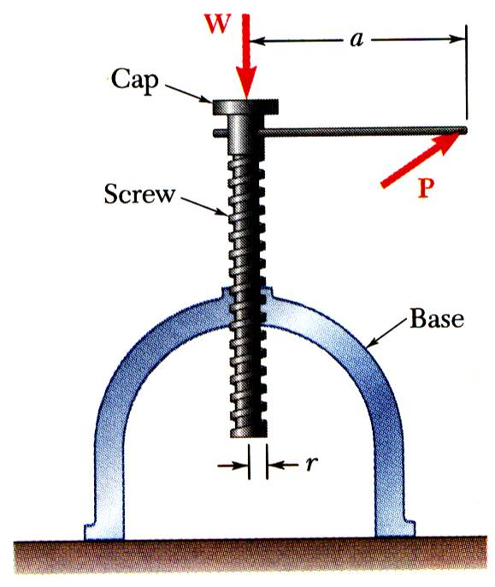
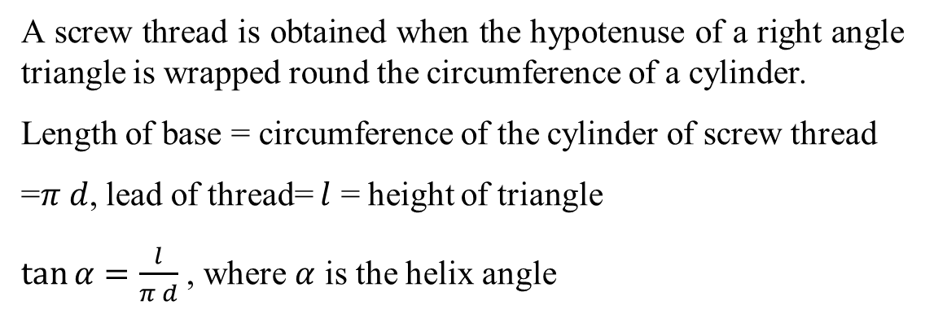
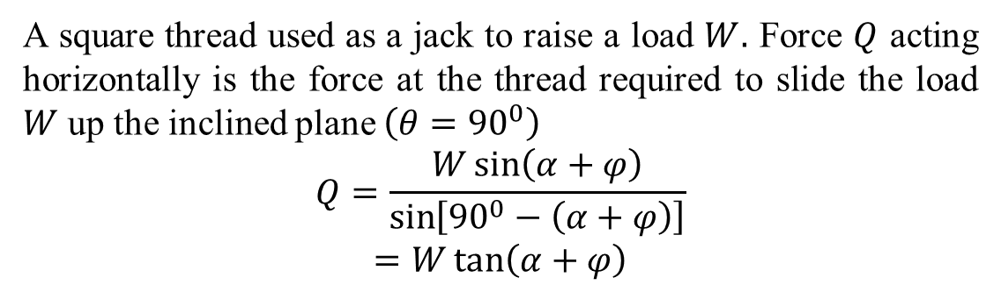
Screw Threads
A screw thread is obtained when the hypotenuse of a right angle triangle is wrapped round the circumference of a cylinder.
Length of base = circumference of the cylinder of screw thread
=$π d$, lead of thread= $l$ = height of triangle
$\tan{α}=\frac{l}{π d}$ , where $α$ is the helix angle
Square thread
A square thread used as a jack to raise a load $W.$ Force $Q$ acting horizontally is the force at the thread required to slide the load $W$ up the inclined plane $\left(θ={90}^{0}\right)$
$$Q=\frac{W\sin\left(α+φ\right)}{\sin\left[{90}^{0}−\left(α+φ\right)\right]}$$
$$=W\tan\left(α+φ\right)$$

Slide 21
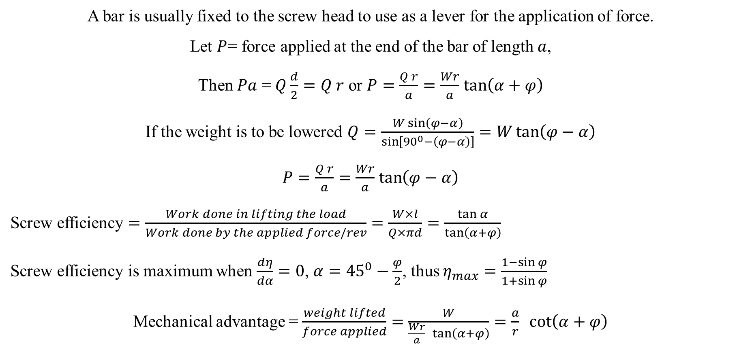
Screw Threads
A bar is usually fixed to the screw head to use as a lever for the application of force.
Let $P$= force applied at the end of the bar of length $a$,
Then $Pa$ = $Q\frac{d}{2}=Q r$ or $P=\frac{Q r}{a}=\frac{Wr}{a}$ $\tan\left(α+φ\right)$
If the weight is to be lowered $Q=\frac{W\sin\left(φ−α\right)}{\sin\left[{90}^{0}−\left(φ−α\right)\right]}=W\tan\left(φ−α\right)$
$P=\frac{Q r}{a}=\frac{Wr}{a}$ $\tan\left(φ−α\right)$
Screw efficiency $=\frac{Work done in lifting the load}{Work done by the applied force/rev}$ $=\frac{W×l}{Q×πd}=\frac{\tan{α}}{\tan\left(α+φ\right)}$
Screw efficiency is maximum when $\frac{dη}{dα}=0$, $α={45}^{0}−\frac{φ}{2}$, thus $η_{max}=\frac{1−\sin{φ}}{1+\sin{φ}}$
Mechanical advantage = $\frac{weight lifted}{force applied}=\frac{W}{\frac{Wr}{a} \tan\left(α+φ\right)}=\frac{a}{r} \cot\left(α+φ\right)$

Slide 22
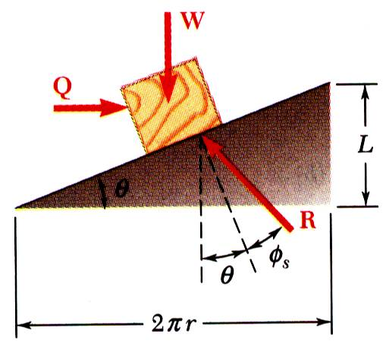
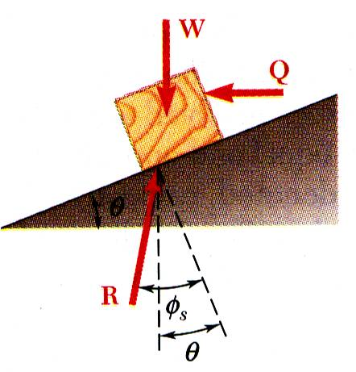
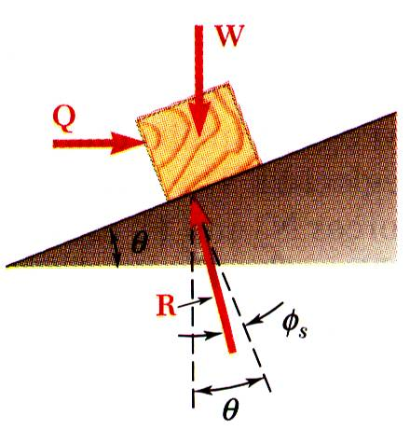
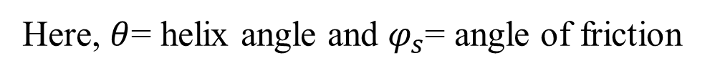
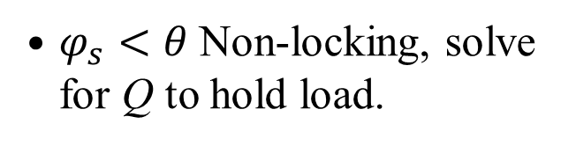
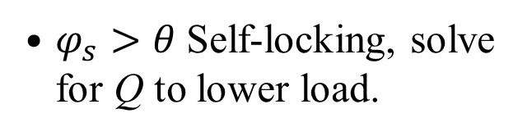
Screw Threads
Impending motion upwards. Solve for Q.
$φ_{s}>θ$ Self-locking, solve for Q to lower load.
$φ_{s}<θ$ Non-locking, solve for Q to hold load.
Here, $θ$= helix angle and $φ_{s}$= angle of friction

Slide 23
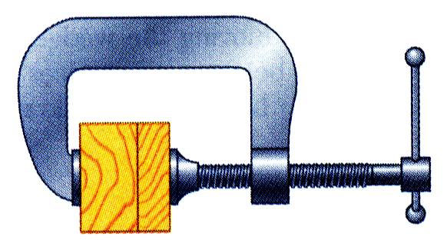
Screw Threads (Problem 1)
A clamp is used to hold two pieces of wood together as shown. The clamp has a double square thread of mean diameter equal to 10 mm with a pitch of 2 mm. The coefficient of friction between threads is μ_{s} = 0.30.
If a maximum torque of 40 N*m is applied in tightening the clamp, determine (a) the force exerted on the pieces of wood, and (b) the torque required to loosen the clamp.

Slide 24
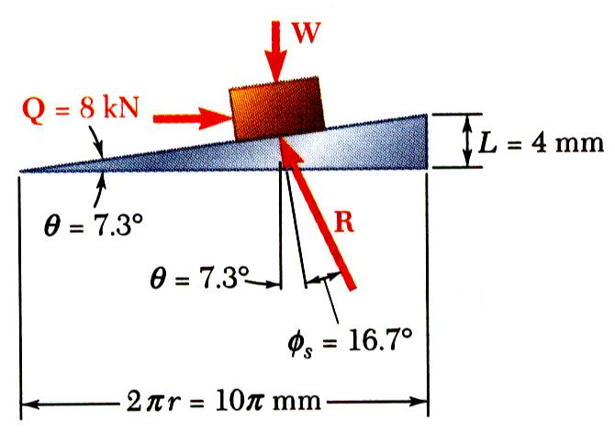
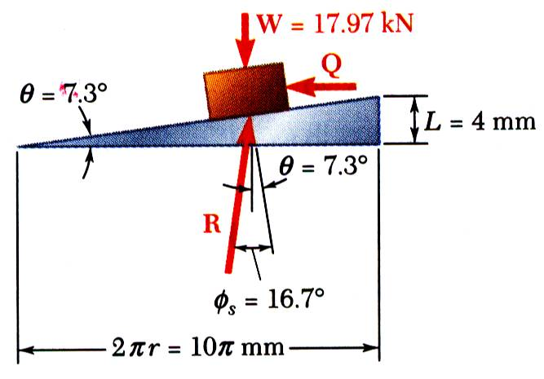
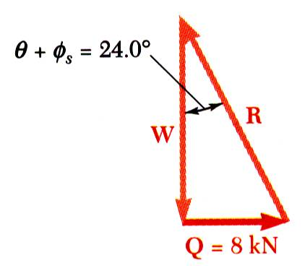
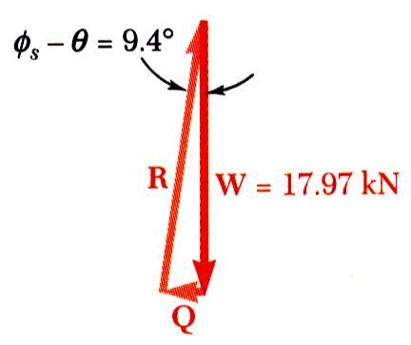
Screw Threads (Problem 1)
Up the plane
Down the plane

Slide 25
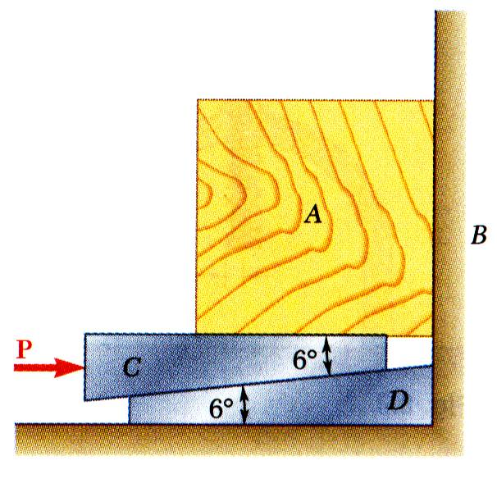
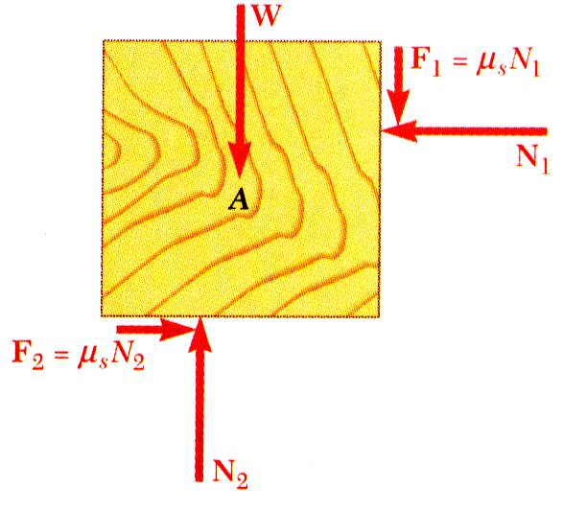
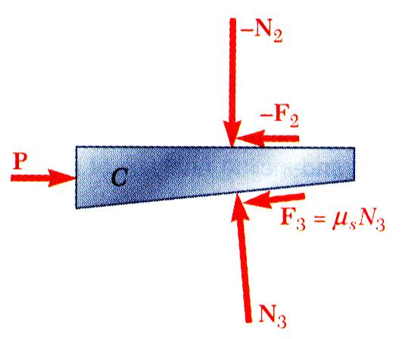
Wedge
Wedges - simple machines used to raise heavy loads.
Force required to lift block is significantly less than block weight.
Friction prevents wedge from sliding out.
Want to find minimum force P to raise block.
Block as free body
Wedge as free body
or
or

Slide 26
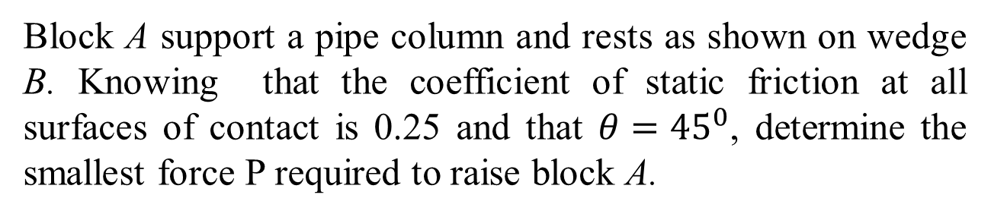
Wedge (Problem 1)
Block A support a pipe column and rests as shown on wedge B. Knowing that the coefficient of static friction at all surfaces of contact is 0.25 and that $θ={45}^{0}$, determine the smallest force P required to raise block A.

Slide 27
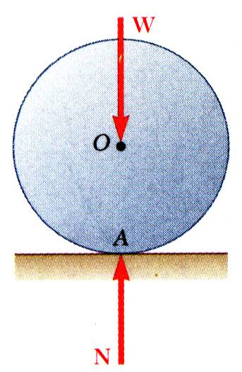
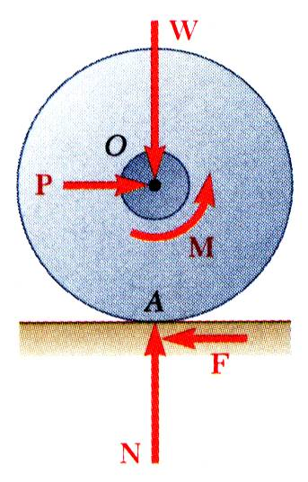

Rolling Resistance
Point of wheel in contact with ground has no relative motion with respect to ground. Ideally, no friction.
Moment M due to frictional resistance of axle bearing requires couple produced by equal and opposite P and F. Without friction at rim, wheel would slide.
Deformations of wheel and ground cause resultant of ground reaction to be applied at B. P is required to balance moment of W about B. Pr = Wb b/r = coefficient of rolling resistance

Slide 28



Rolling Resistance
A pulley of diameter 4 in. can rotate about a fixed shaft of diameter 2 in. The coefficient of static friction between the pulley and shaft is 0.20.
Determine:
SOLUTION:
a. With the load on the left and force P on the right, impending motion is clockwise to raise load. Sum moments about displaced contact point B to find P.
a. the smallest vertical force P required to start raising a 500 lb load,
b. the smallest vertical force P required to hold the load, and
c. the smallest horizontal force P required to start raising the same load.
b. Impending motion is counter-clockwise as load is held stationary with smallest force P. Sum moments about C to find P.
c. With the load on the left and force P acting horizontally to the right, impending motion is clockwise to raise load. Utilize a force triangle to find P.

Slide 29
Rolling Resistance

Slide 30



Belt Friction
Relate T₁ and T₂ when belt is about to slide to right.
Draw free-body diagram for element of belt
Combine to eliminate $∆N$, divide through by $∆θ$,
In the limit as $∆θ$ goes to zero,
Separate variables and integrate

Slide 31


Belt Friction
A flat belt connects pulley A to pulley B. The coefficients of friction are $μs$ = 0.25 and $μk$ = 0.20 between both pulleys and the belt.
Knowing that the maximum allowable tension in the belt is 600 lb, determine the largest torque which can be exerted by the belt on pulley A.

Slide 32
Acknowledgement
NPTEL lectures on Engineering Mechanics
Beer & Johnston, Vector Mechanics for Engineers
Meriam & Kraige, Engineering Mechanics
Problems taken from internet sources
Timoshenko & Young, Engineering Mechanics
S S Rattan, Theory of Machine

